Slide 1
The Merchant of Venice
William Shakespeare

Slide 2
Background of the play
Written some time around 1597
Written as a romantic comedy since it is about love and ends happily
Fuses many dramatic elements: romantic courtship, riddling love tests, eloping lovers, comic confusions, a gripping courtroom trial, and a seemingly harmonious final act
At the core of the play is Shylock, the Jewish moneylender. He only appears in five of the 20 scenes, but his presence dominates the play.

Slide 3
Source of the play
Roots of Shakespearean drama begin with mystery and miracle plays of the Middle Ages, which were performed by the church for a largely illiterate audience about Old and New Testament stories. Jews were often viewed as responsible for Christ’s crucifixion.
Jews became the evil villains of Elizabethan drama. They were one-dimensional stereotypical characters.
The Jew of Malta, written in 1589 by Christopher Marlowe, is one such work. Marlowe was Shakespeare greatest rival.

Slide 4
The Jew of Malta
The Merchant of Venice
Barabbas is a villain who steals, cheats, and indulges in murder until he finally meets a gruesome end, boiling in oil.
Both money-lenders
Both have daughters who leave home with father’s money
Both despicable characters
Shylock is presented as a complex man, whose every action can be understood, and who ultimately elicits sympathy from the modern audience.
Notes:
Despicable-wretched, Elicits-evokes.

Slide 5
Jews in England
1075 in Oxford: Jews were not confined to ghettos as many of their European counterparts, but they were not allowed to be citizens. Because Christians could not lend money with interest, many Jews earned lucrative livings as usurers. In trying to regain debt owed to them, Jews became the target of resentment.
Late 12th Century: Anti-Semitic sentiment culminated in two massacres, one at the coronation of Richard I in 1189 (30 Jews killed), and the other in the city of York in 1190 (150 Jews killed).
In fact, the Magna carta, is a testament to growing Anti-Semitic feelings—two clauses state that if a debtor dies debt is paid, neither heir or widow is responsible for paying it.
1275: Jews forbidden to be money-lenders as well as other edicts implemented: taxation of Jews over 12 years old and wearing badges that identified them as Jews.
1290 (until 1655): Expelled from England

Slide 6
Shakespeare’s Intent?
Given the anti-Jewish climate in Elizabethan England and Shakespeare’s portrayal of Shylock as a negative stereotype, it would be reasonable to assume Shakespeare was an Anti-Semite.
However, the rest of the details of the play do not support this.
It has been suggested that the real evil is the corrupt value system of the principal Christian characters. Antonio, the merchant of the title, is the worst bigot Portia is also a racist, but not only were Jews her only victims.
Notes:
Bigot-A prejudiced person who is intolerant of any opinions differing from his own

Slide 7
Influence on Anti-Semitism
Regardless of what Shakespeare's own intentions may have been, the play has been made use of by anti-semites throughout the play's history.
One must note that the end of the title in the 1619 edition "With the Extreme Cruelty of Shylock the Jew…" must aptly describe how Shylock was viewed by the English public.
The Nazis used the usurious Shylock for their propaganda. Shortly after Kristallnacht in 1938, "The Merchant of Venice" was broadcast for propagandistic ends over the German airwaves. Productions of the play followed in Luberk (1938),Berlin (1940), and elsewhere within the Nazi Territory.
The depiction of Jews in English literature throughout the centuries bears the close imprint of Shylock. With slight variations much of English literature up until the 20th century depicts the Jew as “a moneyed, cruel, lecherous, avaricious outsider tolerated only because of his golden hoard”.
Notes:
Shylock-Someone who lends money at excessive rates of interest.
Kristallnacht, also referred to as the Night of Broken Glass, The attacks left the streets covered with broken glass from the windows of Jewish-owned stores, buildings, and synagogues.At least 91 Jews were killed in the attacks, and a further 30,000 arrested and incarcerated in concentration camps. Jewish homes, hospitals, and schools were ransacked, as the attackers demolished buildings with sledgehammers. Over 1,000 synagogues were burned (95 in Vienna alone), and over 7,000 Jewish businesses destroyed or damaged.

Slide 8
Why do the Christians hate the Jews?
The killing of Christ. If they did not convert then they could not be ‘saved.’
The stereotype of a Jew. In medieval times it was rumoured that Jews killed children and drank blood. Ritual sacrifice is hinted at in Act Four, scene one.
The practice of usury. Money-lending was an unpopular profession.

Slide 9
Story introduction
Long time ago, a man called Antonio lived in Venice. He was merchant, owning many ships which traded with distant countries. And he was a good man as well as a rich one. His best friend Bassanio, who fell in love with a beautiful and rich lady called Portia, was not a wealthy man. So he didn’t ask Portia to marry him.
At last, he asked Antonio to lend him some money, so that he could visit Portia at Belmont. It happened that time all Antonio’s shops were at sea, and he wouldn’t have money to lend Bassanio until the ships returned. So they decided to go to a money-lender.
Now, an old Jew named Shylock lived in Venice. The Jews in those days were the money-lenders of Venice. He asked Antonio to sign a bond promising that he might cut off a pound of flesh from Antonio’s body if the money was not paid. So Bassanio unwillingly took the money, and sailed away to Belmont.

Slide 10
In fact, Portia loved Bassanio too. So they arranged to get married. However, their happiness was soon disturbed by a bad news: Antonio’s six ships, full of riches, had all been wrecked at sea, which also meant Antonio lost all his money. Shylock was extremely happy after he heard the news and he went to cut off a pound of flesh from Antonio’s body. When he began sharpening the long knife he had brought with him, a lawyer entered. Portia was the lawyer, but none of others knew recognized her. Finally, Portia was so clever that she saved Antonio’s life.

Slide 11
The characters in the play
The Duke of Venice
T he Prince of Marocco
suitors of Portia
The Prince of Aragon
Antonio, a merchant of Venice
Bassanio, his friend, suitor of Portia
Portia, the lady of Belmont
Shylock, a jew of Venice
Gratiano
Salerio friends of Antonio e Bassanio
Solanio
Lorenzo, in love with Jessica Balthasar
Nerissa, Portia’s waiting-woman Stephano servants of Portia
Jessica, daughter of Shylock
Tubal, a jew of Venice, Shylock’s friend Launcelot Gobbo, servant of Shylock
Leonardo, servant of Bassanio Old Gobbo, father of Launcelot

Slide 12
Two World
Venice
Language of money, commerce
Male friendship
Justice / letter of law
Belmont
Poetic language
Love / marriage bonds
Mercy / spirit of law

Slide 13
Old Testament vs New Testament
Judaism
Justice / Retribution
Letter of Law
“A Daniel come to judgment”
Christianity
Mercy / Forgiveness
Spirit of Law
“Quality of Mercy is not strained”

Slide 14
PROMINENT-CHARACTERS
1.Shylock
Who He is?
A successful Jewish moneylender who is much maligned over his religion and the practice of moneylenders such as himself of charging interest.
What he does and what happens to him?
He lends the 3000 ducats Bassanio needs to court Portia and hopefully, pay off his debts to Antonio. There is however a catch; if the debt is not repaid, Antonio as security will forfeit one pound of his flesh. It is Shylock who is responsible for the immortal lines, "If you prick us, do we not bleed? if you tickle us, do we not laugh? if you poison us, do we not die? and if you wrong us, shall we not revenge?"

Slide 15
Role １: Usurer/Miser
Shylock is a greedy and heartless moneylender who lends money to Christian.
He ill-treats his servant
He holds his daughter and ducats tightly.

Slide 16
Role ２: Jew
The “Humanity” of Shylock has been proved many times. He is not merely a monster to revile and curse; his viewpoint is fully given and can, on occasion, command the whole sympathy of an audience.
The first full opportunity for this is his sarcastic dialogue with Antonio:
should I bend low, and in a bondman’s key
With bated breath, and whisp’ring humbleness
Say this:
“ Fair sir, you spet on me on Wednesday last,
You spurn’d me a day, another time
You call’d me dog: and for these courtesies
I’ll lend you thus much moneys”? (Ⅰ. iii. II8-24)20’20’’

Slide 17
Role ２: Jew
The next full opportunity for Shylock to state his case is the speech:
Hath not a Jew eyes?
Hath not a Jew hands, organs, dimensions, senses, affections, Passions? fed with the same food, hurt with the same weapons, Subject to the same diseases, healed by the same means, Warmed and cooled by the same winter and summer, as A Christian is? If you prick us, do we not bleed? If you tickle us, do we not laugh? if you poison Us, do we not die? and if you wrong us, shall we not revenge?
(III. i.)52’40’’
Here he claims a hearing on the grounds that he suffers as other men, and will take revenge like them.

Slide 18
Role ２: Jew
So powerful has Shylock’s justification proved, that it is sometimes forgotten that a villain is speaking. It has to be pointed out that “ What is commonly received as Shylock’s plea for tolerance is in reality his justification of an inhuman purpose.” Shakespeare has created in Shylock an outcast who suffers and is driven to extremity in his suffering, but no matter how harshly the Christians treat him, he remains the Jew who intends to kill his enemy, a harsh , cynical, and ruthless villain. Whether his suffering forces him to be a villain, or whether his villainy causes him to suffer, Shakespeare is not concerned to say. But there is a judgment: at the end of the trial scene, Shylock ‘s designs are defeated and he has to accept conversion to Christianity.

Slide 19
ole 3: Father/Master
Besides being a Jew, he is also an old father with a young daughter who escapes from him to escapes from him to marry the man she loves.
Shylock's function in this play is to be the obstacle, the man who stands in the way of the love stories; such a man is a traditional figure in romantic comedies.

Slide 20
He is also a cruel master who refuses to allow his servant (Launcelot Gobbo) being stuffed, which results in Launcelot Gobbo’s betrayal.

Slide 21
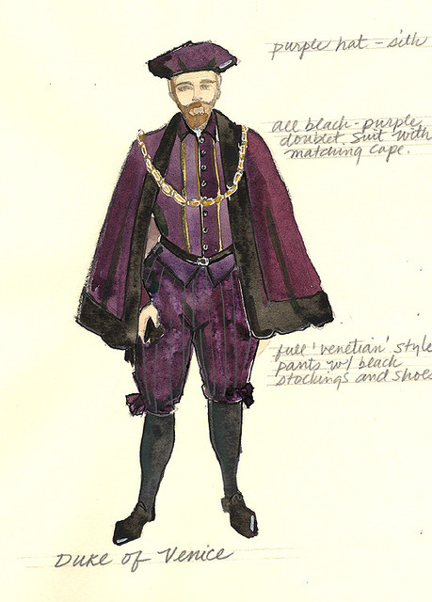
Duke of Venice
Who He is
As judge over the court case between Shylock and Antonio, he has the power to pardon a death sentence
What He does and what happens to Him
In the play, he is put in a difficult position by Shylock; he doesn't want Antonio to die, but to ignore Shylock's legal rights would be to place all of Venice in disrepute as a place to conduct business.

Slide 22
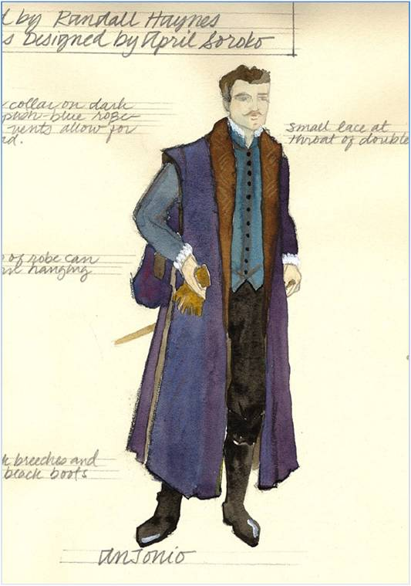
Key words:
generous
noble
warm-hearted
kind
upright
Antonio
Who He is
A Venetian merchant of considerable wealth, he makes his money from "ventures", or mercantile enterprises using his fleet of ships.
What He does and what happens to Him
Much liked by his friends, Salanio, Gratiano and Salarino, Antonio is owed money by his friend Bassanio. The title of this play is considered to be derived from this character as well as the character of Shylock.

Slide 23
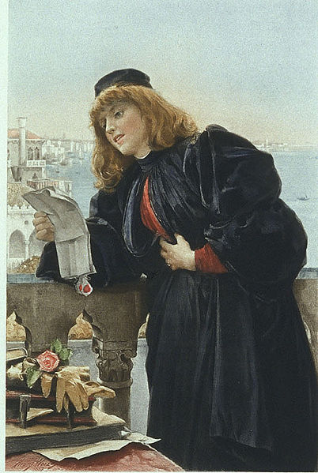
Key Words:
Keen-witted
intelligent
brave
merciful
well-educated
Portia
Portia
Who She is
The heroine of this play, Portia is a wealthy and beautiful woman who is desired by many, so much so that her father has devised an ingenious test all suitors must perform to win her hand in marriage This consists of a suitor choosing one of three casket in which her portrait lies.
What She does and what happens to Her
Far from being merely beautiful, Portia also possesses a sharp mind, one, which saves Antonio from doom at the hands of Shylock.

Slide 24
Quick-witted, wealthy, and beautiful, Portia embodies the virtues that are typical of Shakespeare’s heroines—it is no surprise that she emerges as the antidote to Shylock’s malice.
At the beginning of the play，she is a near prisoner, feeling herself absolutely bound to follow her father’s dying wishes. This opening appearance, however, proves to be a revealing introduction to Portia, who emerges as that rarest of combinations—a free spirit who abides rigidly by rules.

Slide 25
In her defeat of Shylock Portia prevails by applying a more rigid standard than Shylock himself, agreeing that his contract very much entitles him to his pound of flesh, but adding that it does not allow for any loss of blood.
Anybody can break the rules, but Portia’s effectiveness comes from her ability to make the law work for her.

Slide 26
As many people have pointed out that Portia seems like an extremely merciful person , both in the court scene and in her treatment of her suitors.
Portia, one of the play’s leading characters, is functioning as a mere mouthpiece in the play’s climactic scene. She speaks words of a character who never even appears.

Slide 27
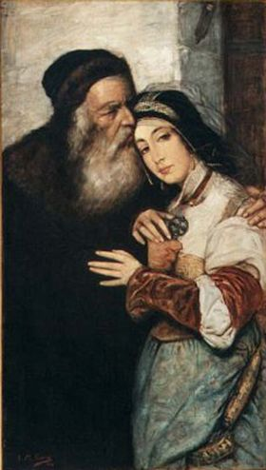
Jes
S
I
ca
Who She is?
The daughter of Shylock
What She does and what happens to She?
Her eloping with the "Christian" Lorenzo and her stealing of his property, angers Shylock greatly.

Slide 28
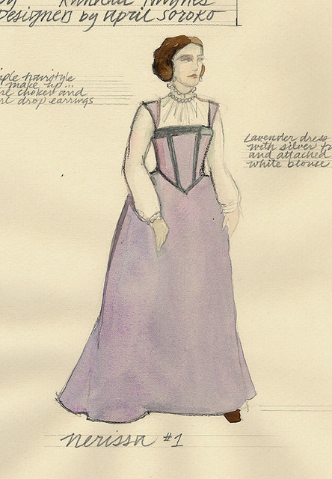
Nerissa
Who is She
Portia's waiting-maid.
What She does and what happens to her
She tends to Portia and also helps Portia save Antonio's life. She later marries Bassanio's friend Gratiano.

Slide 29
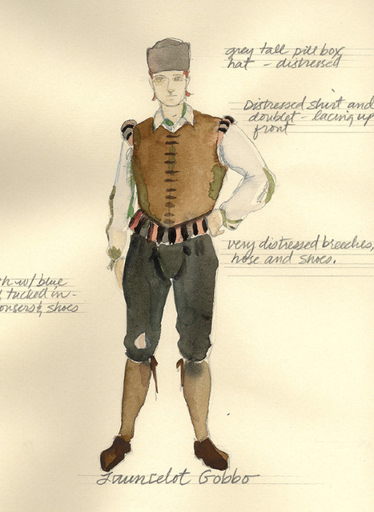
Launcelot Gobbo
Who He is
A clown and servant to Shylock.
What He does and what happens to Him
He aids in the escape of Jessica from Shylock and works for Bassanio.

Slide 30
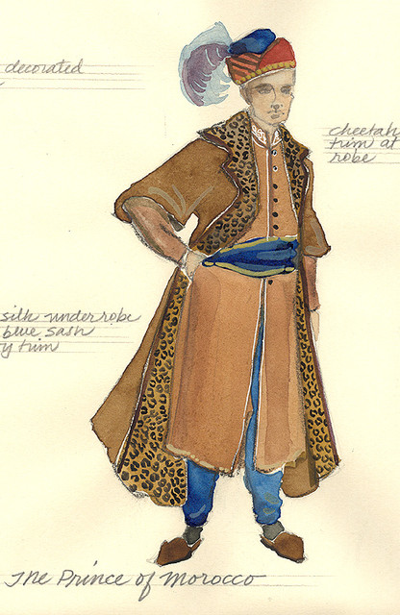
The prince of Morocco
Who He is?
He’s one of Portia's suitors.
What He does and what happens to Him?
He chooses the gold casket, which is the wrong one and loses the right to marry Portia.

Slide 31
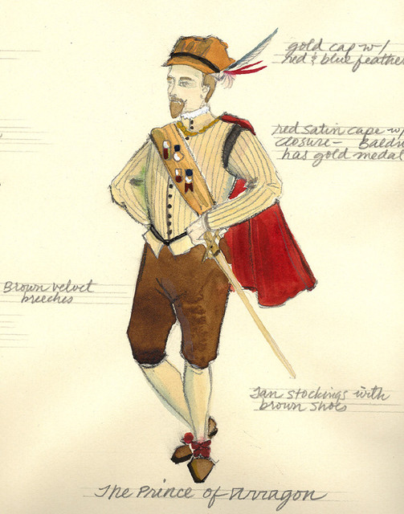
The prince of Arragon
Who He is
As one of Portia's suitors.
What He does and what happens to He
This suitor also fails to win the fair Portia's hand in marriage when he incorrectly chooses the silver casket.

Slide 32
Contrasts Presented in the Play
Jew against Christian
Love against hate
Usury against venture trading
Mercy against justice
Appearances are rarely what the seem: gold and silver prove worthless, identities are mistaken, women disguised as men trick their husbands.

Slide 33
The first half：Shylock intended to revenge and punish Antonio .
（ Shylock’s play）
The second half：Portia intelligently defended Shylock and won the case.
（Portia’s play）

Slide 34
1.The battle between Portia and Shylock can be divided into two rounds.
2.The two rounds of debate can be divided into three parts.
3.In what way did Portia won？
4.From the two rounds of debate，what’s the feeling impacting on the audience？
Portia
Shylock
Ask for mercy
Triple payback
Ask for doctor
Concede
3times
Refuse 3times
Must cut，law permission，verdict of the court
Threaten the life of the citizen, confiscate property, lose the suit

Slide 35
Three plots
Casket plot
(Act I – III) Resolved with marriage of Portia and Bassanio
Pound of Flesh plot
(Act I – IV) Resolved with Court scene
Ring plot
(Act III – V) Resolved with reconciliation scene between Portia and Bassanio, Nerissa and Gratiano

Slide 36
Connection between plots
Casket plot
Bassanio needs money to woo Portia, thus borrows money from Antonio who need to borrow from Shylock, the Pound of Flesh plot
Bassanio fulfills Portia’s father’s requirements but says contract isn’t final “until ratified by you.” Portia has fulfilled duty to father by marrying, but Ring plot allows her “out.”
Ring plot tests whether Bassanio was really willing to risk and hazard all he had for love.

Slide 37
Connection between plots
Pound of Flesh plot
Antonio borrows money from Shylock so Bassanio can woo Portia, the Casket plot
Portia also is the justice who pronounces sentence on Shylock for his attempt on Antonio’s life, the Pound of Flesh plot
Portia’s role in saving Antonio and their desire to show their gratitude allows her the opportunity to request the ring from Bassanio as payment, affecting the Ring plot

Slide 38
Connection between plots
Ring plot
The gift of the ring by Portia to Bassanio culminates the Casket plot as a symbol for their love and marriage
Portia’s role in rescuing Antonio allows her to request the ring as payment from Bassanio, connecting it to the Pound of Flesh plot
By giving the ring to Antonio to give to Bassanio, Portia overrides the male bond and makes him an advocate for their marriage as most important bond.

Slide 39
Potential conflict for Bassanio’s love
Bassanio
Love / Friendship
Love / Marriage
Potential conflict
Antonio
Portia

Slide 40
Bassanio’s bonds
Father/Son-like and/or friendship relationship with Antonio
Father of Portia/Suitor bond through Casket choice
Husband/Wife bond with Portia
Love bond/promise through acceptance of ring
Gratitude bond with Ballerio (Portia in disguise as Doctor of Law)

Slide 41
Couples
Portia / Bassanio
Realistic couple – not just bond with father, must include love (excessive feeling but trying to maintain golden mean)
Nerissa / Gratiano
Sexual couple – bet “stake down” and protecting Nerissa’s “ring”
Jessica / Lorenzo
Romantic Couple – references to famous lovers

Slide 42
Who was Merchant of Venice?
Antonio
Has many ships in various parts of the world
Shylock
Lends out money for profit
Bassanio
Gentleman, but the one who ends up with the “Golden Fleece”: Portia, her father’s fortune

Slide 43
Themes in the play
2. Money as a motivating factor
Seen in the love and ‘bond’ plot of the play. Bassanio needs money to woo Portia; lack of it puts Antonio in Shylock’s power.
Attitudes to money differ: both merchants view it differently (one gives it away while the other is greedy for it - usury seen as morally wrong), Jessica and Bassanio waste it, it does not make Antonio / Portia happy.
Bassanio is not taken in by material wealth in the casket test.
Portia (the ‘Golden Fleece’) gives away her wealth for love. Shylock prefers his ducats to his daughter.

Slide 44
Themes in the play
3. Love, marriage and friendship
Portia plays the stereotypical role of an Elizabethan woman, dutiful to her father / husband and giving up all she has.
Antonio shows platonic love for Bassanio – he is prepared to give up his life for him.
The play shows the triumph of love / friendship over greed. Shylock hates Antonio because of his business practice, it stops his profit. Act four, scene one shows the extent of his greed.

Slide 45
Appearance Vs. Reality…
Appearances can be deceiving.The Merchant of Venice warns us repeatedly that outer beauty is not necessarily evidence of inner worth. As the motto on the gold casket puts it: "All that glisters is not gold."
There is some belief that the emphasis on this moral is out of place in the play. After all, Portia the heroine turns out to be as good and wise as she is beautiful and rich.
The rewards from all worthwhile relationships can be achieved only when the partners open their hearts to each other. By the same reasoning, money itself is not necessarily a bad thing - but you must be careful to love it for the good it can do. Shylock's failing is not that he is rich, but that he seeks to use his money for an evil end – revenge!

Slide 46
Mercy Vs. Revenge…
A number of Shakespeare's plays are concerned with the question of justice and the nature of legitimate authority. The Merchant of Venice poses the question of whether the law should be tempered by mercy, or whether it should be morally neutral.
If neutral, then the law can become a tool in the hands of men such as Shylock, who use it to further their own personal vendettas.
In Act IV of the play, we find Portia arguing that the justice of the state, like God's justice, ought to be merciful. Mercy does triumph eventually in this courtroom scene, but not until Portia reveals a legal loophole which makes it possible for the Duke to rule in her favour.
In the world of this comedy, at least, the conflict between morally neutral law and merciful law is easily resolved. Readers do disagree, however, as to how well the theme of mercy's triumph over revenge is carried out by the "good" characters' treatment of Shylock.
You will have to decide for yourself whether Shylock's punishment at the end of the trial scene is truly merciful- or whether he in fact becomes the victim of an unconscious streak of vengefulness in the character of Antonio.

Slide 47
.
PORTIA: The quality of mercy is not strain'd,
It droppeth as the gentle rain from heaven Upon the place beneath: it is twice blest; It blesseth him that gives and him that takes: 'Tis mightiest in the mightiest: it becomes The throned monarch better than his crown; His sceptre shows the force of temporal power, The attribute to awe and majesty, Wherein doth sit the dread and fear of kings; But mercy is above this sceptred sway; It is enthroned in the hearts of kings, It is an attribute to God himself; And earthly power doth then show likest God's When mercy seasons justice. Therefore, Jew, Though justice be thy plea, consider this, That, in the course of justice, none of us Should see salvation: we do pray for mercy; And that same prayer doth teach us all to render The deeds of mercy. I have spoke thus much To mitigate the justice of thy plea; Which if thou follow, this strict court of Venice Must needs give sentence 'gainst the merchant there.

Slide 48
Shylock’s conversion to Christianity
From Christians’ point of view
Shylock cannot be “saved” without Christ
They are doing him a favor
From Jews’ point of view
Shylock is condemned to be without society
He cannot associate with other Jews
The Christians won’t really accept him
They are imposing a penalty worse than losing all his money

Slide 49
A Brief Comment on The Social Significance of “The Merchant of Venice”

Slide 50
Great irony and comedy
The script is the subject of friendship and love,
At the same time also reflects the business of early capitalism and the bourgeoisie sharks conflict between the performances of the authors of bourgeois society, money, Legal and religious issues such as the humanistic ideas. It plays an important literary achievement; this Shylock is the shape of the mercenary,

Slide 51
the social significance of this play in modern times
Firstly, the play has an unreasoning prejudice against the Jews.
Secondly, the play talk talks about the Christians' hypocrisy.
false standards of friendship and love, and
their cunning ways of pursuing worldliness

Slide 52
FAMOUS QUOTES
"If you prick us, do we not bleed? if you tickle us, do we not laugh? if you poison us, do we not die? and if you wrong us, shall we not revenge?". – (Act III, scene I).
"The devil can cite scripture for his purpose". -(Act I, sce. III).
"I like not fair terms and a villain's mind". - (Act I, scene III)
I hold the world but as the world, Gratiano, A stage, where every man must play a part; And mine a sad one. (Act i. scene. 1.)
Superfluity comes sooner by white hairs, but competency lives longer. (Act i. sce. 2. )
I dote on his very absence. (Act i. scene. 2.)

Slide 53
Mislike me not for my complexion, The shadow’d livery of the burnish’d sun. (Act ii. scene. 1. )
It is a wise father that knows his own child. (Act ii. sce. 2.)
In the twinkling of an eye. ( Act ii. scene. 2. )
But love is blind, and lovers cannot see The pretty follies that themselves commit. (Act ii. sce. 6.)
All that glisters is not gold. (Act ii.)

Slide 54
Antonio
Anti-Semitic? calls Shylock “cur,” “dog” and spits on him, but does not take a share of Shylock’s estate at the end. Does however force him to convert to Christianity (‘saving’ him?)
Portia
She Used to present the idea of mercy, but does she really show it?
Ruthless / clever in dealing with Shylock.

Slide 55
Thank You

